Slide 1


Representing Knowledge in an Uncertain Domain
The Semantics of Bayesian Networks
Probabilistic reasoning
Assistant Professor
IT-ICT Department, LJIET
prayag.patel@ljinstitutes.edu.in
Mr. Prayag Patel

Slide 2
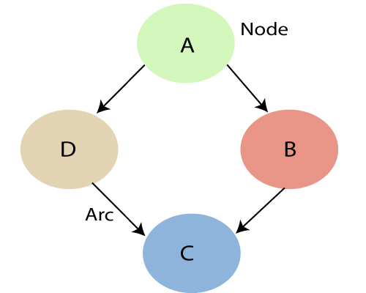

Representing Knowledge in an Uncertain Domain
Bayesian Networks
"A Bayesian network is a probabilistic graphical model which represents a set of variables and their conditional dependencies using a directed acyclic graph.“
A Bayesian network graph is made up of nodes and Arcs where:
Each node corresponds to the random variables, and a variable can be continuous or discrete.
Arc or directed arrows represent the causal relationship or conditional probabilities between random variables.
Bayes' theorem
Mr. Prayag Patel
Department: IT/ICT-LJIET

Slide 3
Representing Knowledge in an Uncertain Domain
Bayesian Networks
A directed graph in which each node is annotated with quantitative probability information
Definition
Each node corresponds to a random variable, which may be discrete or continuous
A set of directed links or arrows connects pairs of nodes. ( If there is an arrow from node X to node Y , X is said to be a parent of Y. )
The graph has no directed cycle.
Each node Xi has a conditional probability distribution P(Xi|Parents(Xi)) that quantifies the effect of the parents on the node.
Mr. Prayag Patel
Department: IT/ICT-LJIET

Slide 4
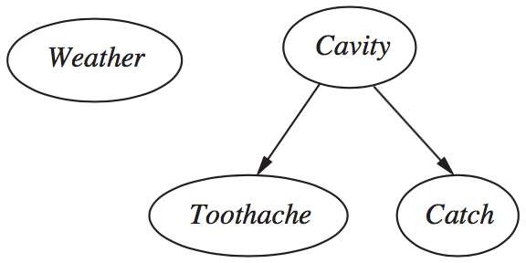
Simple Example of Bayesian Networks
Representing Knowledge in an Uncertain Domain
The variables Toothache , Cavity, Catch, and Weather.
Weather is independent of the other variables Toothache and Catch are conditionally independent, given Cavity.
Cavity is a direct cause of Toothache and Catch
no direct causal relationship exists between Toothache and Catch.
Mr. Prayag Patel
Department: IT/ICT-LJIET

Slide 5
Complex Example of Bayesian Networks
Representing Knowledge in an Uncertain Domain
The variables Burglary, Earthquake, Alarm, MaryCalls and JohnCalls
New burglar alarm installed at home
Fairly reliable at detecting a burglary
Also Responds on minor earthquakes
Two neighbors, John and Mary
They call you at work when they hear the alarm
John almost always calls when he hears the alarm But sometimes confuses the telephone ringing
Mary likes rather loud music and misses to hear the alarm
Give the evidence of who has or has not called, then estimate the probability of a burglary
Mr. Prayag Patel
Department: IT/ICT-LJIET

Slide 6
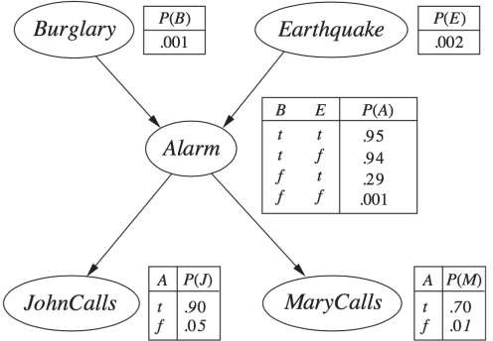
Complex Example of Bayesian Networks
Representing Knowledge in an Uncertain Domain
Burglary and Earthquakes directly affect the probability of the alarm’s going off
John and Mary call depends only on the alarm
The network represents our assumptions that they do not perceive burglaries directly, they do not notice minor earthquakes, and they do not confer before calling
Mr. Prayag Patel
Department: IT/ICT-LJIET

Slide 7
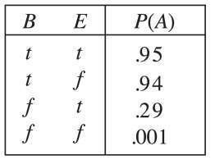
Complex Example of Bayesian Networks
Representing Knowledge in an Uncertain Domain
Conditional Probability Table(CPT)
Each row contains the conditional probability of each node value
Conditioning case is a combination of values for the parent nodes
Each row must sum to 1
The entries represent an exhaustive set of cases for the variable
For Boolean variables, The probability of a true value is p, the probability of false must be 1 – p
Boolean variable with k Boolean parents contains 2k specifiable probabilities
A node with no parents has only one row, representing the prior probabilities of each possible value of the variable
Mr. Prayag Patel
Department: IT/ICT-LJIET

Slide 8
Complex Example of Bayesian Networks
Representing Knowledge in an Uncertain Domain
The Conditional probability of Alarm A depends on Burglar and earthquake
The Conditional probability of Johncalls that he will call depends on the probability of Alarm.
The Conditional probability of Maryalls that he will call depends on the probability of Alarm.
Mr. Prayag Patel
Department: IT/ICT-LJIET

Slide 9
Complex Example of Bayesian Networks
Representing Knowledge in an Uncertain Domain
P(B= True) | P(B= False)
0.001 | 0.999
P(E= True) | P(E= False)
0.002 | 0.998
P(A= True) | P(A= False)
0.95 | 0.05
0.94 | 0.06
0.29 | 0.71
0.001 | 0.999
P(J= True) | P(J= False)
0.90 | 0.10
0.05 | 0.95
P(M= True) | P(M= False)
0.70 | 0.30
0.01 | 0.99
Mr. Prayag Patel
Department: IT/ICT-LJIET

Slide 10
The Semantics of Bayesian Networks
The two ways to understand the meaning of Bayesian Networks
To see the network as a Representation of the joint probability distribution
  To be helpful in understanding how to construct networks
To view it as an encoding of a collection of conditional independence statements
  To be helpful in designing inference procedures
Mr. Prayag Patel
Department: IT/ICT-LJIET

Slide 11
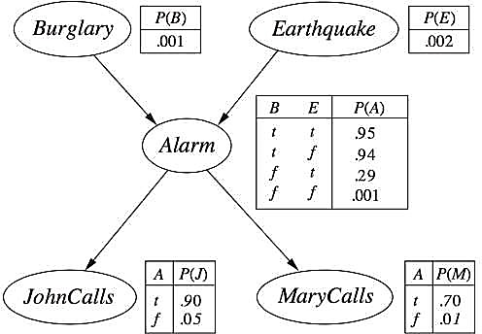

1) Representing the full joint distribution
The Semantics of Bayesian Networks
Full joint distribution
𝑛
$$\prod_{i=1}^{n}{\left.θ(xi | parents(Xi)\right)}$$
P(x1, . . . , xn) =
EX. : The alarm has sounded(a), but neither a burglary(b) nor an earthquake has occurred(e), and both John(j) and Mary(m) call
P(j,m,a,¬b,¬e) = P(j|parents(j))P(m|parents(m)P(a|parents(a)) P(¬b |parents(¬b))P(¬e |parents(¬e))
= P(j|a) P(m|a) P(a|¬b ∧ ¬e) P(¬b) P(¬e)
= 0.90 × 0.70 × 0.001 × 0.999 × 0.998 = 0.000628
Mr. Prayag Patel
Department: IT/ICT-LJIET

Slide 12

1) Representing the full joint distribution
The Semantics of Bayesian Networks
A method for constructing Bayesian networks
How to construct a GOOD Bayesian network
Full Joint Distribution
P(x₁, . . . , x_{n}) = $∏_{i=1}^{n}\text{P}\text{(}\text{xi}\text{ | }\text{x}\text{i}\text{−}\text{1}\text{, . . . , }\text{x}\text{1}\text{)}$
$\text{P}\text{(}\text{xi}\text{ |}\text{xi}\text{−}\text{1}\text{, . . . , }\text{x}\text{1}\text{)}$ = $∏_{i=1}^{n}$ P(X_{i} |Parents(X_{i}))
Correct representation
only if each node is conditionally independent of its other predecessors in the node ordering, given its parents
The parents of node Xi should contain all those nodes in x₁, . . . , x_{i-1} that directly influence x_{i}
Mr. Prayag Patel
Department: IT/ICT-LJIET

Slide 13
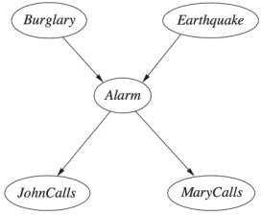
1) Representing the full joint distribution
The Semantics of Bayesian Networks
A method for constructing Bayesian networks
Ex.: Suppose we have completed the network in Figure except for choices of parents for MaryCalls
    MaryCalls is certainly influenced by whether there is a Burglary or an Earthquake, but not directly influenced
    Also, given the state of the alarm, whether John calls has no influence on Mary’s calling
P(MaryCalls | JohnCalls, Alarm, Earthquake, Burglary)
= P(MaryCalls | Alarm)
Mr. Prayag Patel
Department: IT/ICT-LJIET

Slide 14
1) Representing the full joint distribution
The Semantics of Bayesian Networks
Compactness and node ordering
Bayesian network can often be far more compact than the full joint distribution.
It may not be worth the additional complexity in the network for the small gain in accuracy.
The correct procedure for adding a node is to first add the root cause first and then give the variables that they affect.
Mr. Prayag Patel
Department: IT/ICT-LJIET

Slide 15
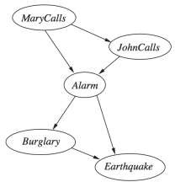
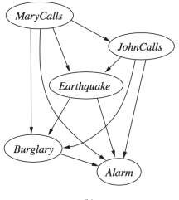
1) Representing the full joint distribution
The Semantics of Bayesian Networks
Compactness and node ordering
We will get a compact Bayesian network only if we choose the node ordering well. What happens if we happen to choose the wrong order?
MaryCalls→JohnCalls
→ Alarm→Burglary
→Earthquake
MaryCalls→JohnCalls
→Earthquake→Burglary →Alarm
Burglary→Earthquake
→Alarm→MaryCalls
→JohnCalls
Mr. Prayag Patel
Department: IT/ICT-LJIET

Slide 16
2) Conditional independence relations in Bayesian networks
The Semantics of Bayesian Networks
Numerical” semantics
  Full Joint Distribution
“Topological” semantics
  Conditional independence relationships by the graph structure
The “numerical” semantics and the “topological” semantics are equivalent
Mr. Prayag Patel
Department: IT/ICT-LJIET

Slide 17
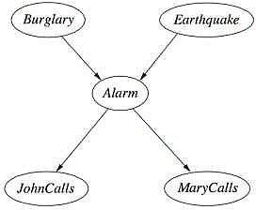
2) Conditional independence relations in Bayesian networks
The Semantics of Bayesian Networks
The topological semantics specifies that each variable is conditionally independent of its non-descendants, given its parents.
Ex.: JohnCalls is independent of Burglary, Earthquake, and MaryCalls given the value of Alarm
Mr. Prayag Patel
Department: IT/ICT-LJIET

Slide 18
2) Conditional independence relations in Bayesian networks
The Semantics of Bayesian Networks
A node is conditionally independent of all other nodes in the network, given its parents, children, and children’s parents(Markov blanket)
Ex.: Burglary is independent of JohnCalls and MaryCalls, given Alarm and Earthquake
Mr. Prayag Patel
Department: IT/ICT-LJIET

Slide 19
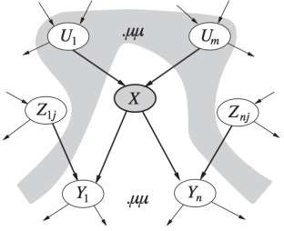
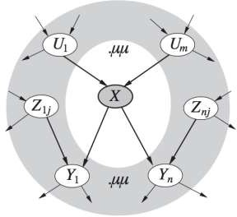
2) Conditional independence relations in Bayesian networks
The Semantics of Bayesian Networks
A node X is conditionally independent of its non- descendants (e.g., the Z_{ij}s) given its parents (the U_{i}s shown in the gray area)
A node X is conditionally independent of all other nodes in the network given its Markov blanket (the gray area).
Mr. Prayag Patel
Department: IT/ICT-LJIET

Slide 20
Efficient Representation of Conditional Distributions
Probabilistic reasoning
Assistant Professor
IT-ICT Department, LJIET
prayag.patel@ljinstitutes.edu.in
Mr. Prayag Patel

Slide 21
Efficient Representation of Conditional Distributions
CPT cannot handle large number or continuous value varibles.
Relationships between parents and children are usually describable by some proper canonical distribution.
Use the deterministic nodes to demonstrate relationship.
Values are specified by some function.
  nondeterminism(no uncertainty)
  Ex. X = f(parents(X))
  Can be logical
    NorthAmerica ↔ Canada ∨ US ∨ Mexico
  Or numercial
    Water level = inflow + precipitation – outflow - evaporation
Mr. Prayag Patel
Department: IT/ICT-LJIET

Slide 22
Efficient Representation of Conditional Distributions
Uncertain relationships can be characterized by noisy logical relationships.
Ex. noisy-OR relation.
  Logical OR with probability
  Ex. Cold ∨ Flu ∨ Malaria → Fever
    In the real world, catching a cold sometimes does not induce fever.
    There is some probability of catching a cold and having a fever.
Mr. Prayag Patel
Department: IT/ICT-LJIET

Slide 23
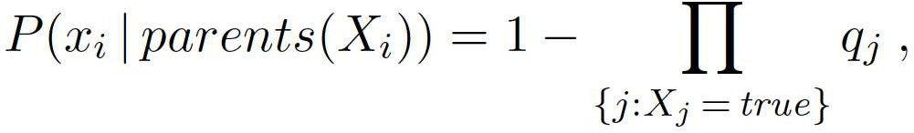
Efficient Representation of Conditional Distributions
Noisy-OR
All possible causes are listed. (the missing can be covered by leak node)
Compute probability from the inhibition probability
Mr. Prayag Patel
Department: IT/ICT-LJIET

Slide 24
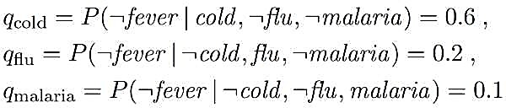
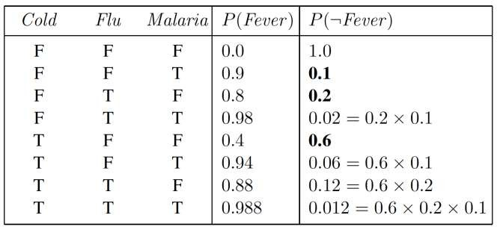
Efficient Representation of Conditional Distributions
Suppose these individual inhibition probabilities are as follows:
Variable depends on k parents can be described using O(k) parameters instead of O(2k)
Mr. Prayag Patel
Department: IT/ICT-LJIET

Slide 25
Efficient Representation of Conditional Distributions
Bayesian nets with continuous variables
Many real world problems involve continuous quantities
  Infinite number of possible values
  Impossible to specify conditional probabilities
Discretization
  dividing up the possible values into a fixed set of intervals
  It’s often results in a considerable loss of accuracy and very large CPTs
To define standard families of probability density functions(Gaussian,etc )
Mr. Prayag Patel
Department: IT/ICT-LJIET

Slide 26
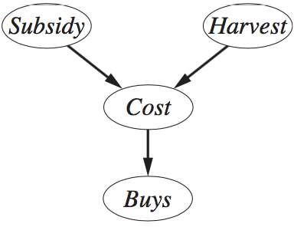
Efficient Representation of Conditional Distributions
Bayesian nets with continuous variables
Hybrid Bayesian network
Have both discrete and continuous variables
Two new kinds of distributions
  variable Continuous variable given discrete or continuous parents
  Discrete given continuous parents
Example
Customer buys some fruit depending on its cost which depends in turn on the size of the harvest and whether the government’s subsidy scheme is operating.
D
C
C
D
Mr. Prayag Patel
Department: IT/ICT-LJIET

Slide 27
Efficient Representation of Conditional Distributions
Bayesian nets with continuous variables
Hybrid Bayesian network
P(Cost|Harvest , Subsidy )
  Subsidy(Discrete)
  P(Cost|Harvest,subsidy) and P(Cost|Harvest,¬subsidy)
Harvest(Continuous)
  How the distribution over the cost c depends on the continuous value h of Harvest
  Specify the parameters of the cost distribution as a function of h
D
C
C
D
Mr. Prayag Patel
Department: IT/ICT-LJIET

Slide 28
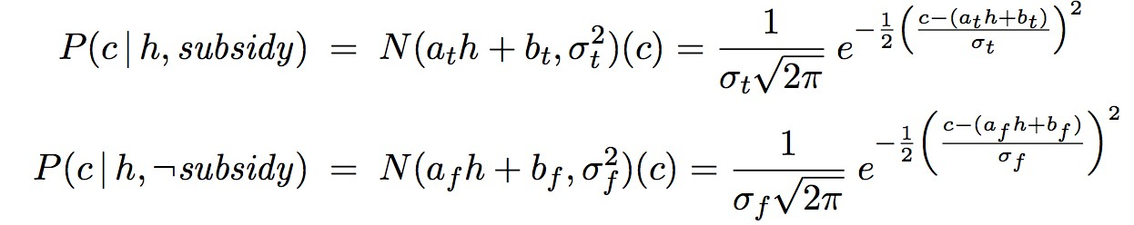
Efficient Representation of Conditional Distributions
Bayesian nets with continuous variables
Hybrid Bayesian network
The linear Gaussian distribution
Most common choice
The child has a Gaussian distribution
  GD has μ varies linearly with the value of the parent
  GD has standard deviation σ that is fixed
Two distributions, subsidy and ¬subsidy, with different parameters at, bt, σt, af , bf , and σf:
Mr. Prayag Patel
Department: IT/ICT-LJIET

Slide 29
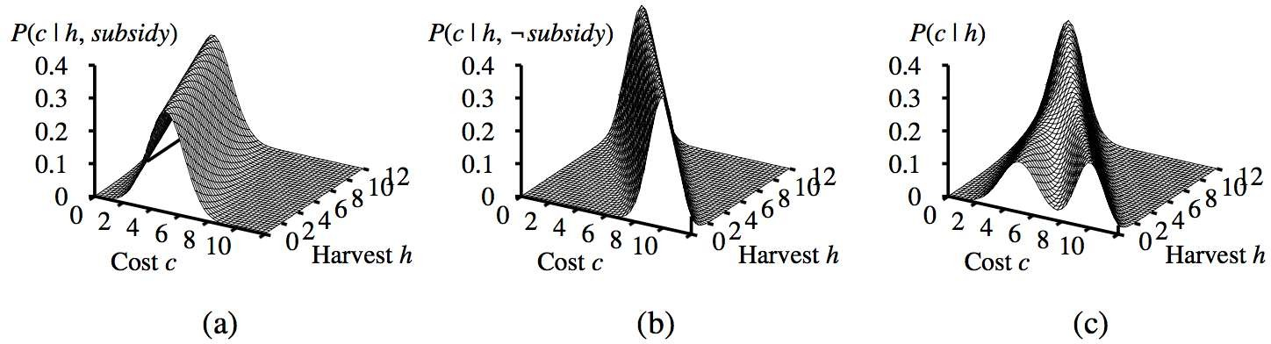
Efficient Representation of Conditional Distributions
Bayesian nets with continuous variables
Hybrid Bayesian network
A : P(Cost|Harvest,subsidy)
B : P(Cost|Harvest,¬subsidy)
C : P (c | h)
averaging over the two possible values of Subsidy
assuming that each has prior probability 0.5
Mr. Prayag Patel
Department: IT/ICT-LJIET

Slide 30

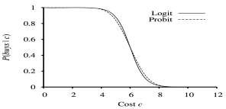

Efficient Representation of Conditional Distributions
Bayesian nets with continuous variables
Other Distribution
Distributions for discrete variables with continuous parents
Consider the Buys node
  Customer will buy if the cost is low
  Customer will not buy if it is high
  the probability of buying varies smoothly
Probit Distribution
D
C
C
D
Logit Distribution
Mr. Prayag Patel
Department: IT/ICT-LJIET

Slide 31
Exact Inference in Bayesian Networks
Probabilistic reasoning
Assistant Professor
IT-ICT Department, LJIET
prayag.patel@ljinstitutes.edu.in
Mr. Prayag Patel

Slide 32
Exact Inference in Bayesian Networks
The task for probabilistic inference system
given some observed event
  some assignment of values to a set of evidence variables
compute the posterior probability distribution for a set of query variables
Ex(In the burglary network)
observe JohnCalls = true and MaryCalls = true
the probability that a burglary has occurred:
Mr. Prayag Patel
Department: IT/ICT-LJIET

Slide 33

Exact Inference in Bayesian Networks
Inference by enumeration
Any conditional probability can be computed by summing terms from the full joint distribution
X denotes the query variable;
E denotes the set of evidence variables E1, . . . ,Em, and e is a particular observed event;
Y will denotes the nonevidence, nonquery variables Y1, . . , Yl (called the hidden variables)
The complete set of variables is X={X}𝖴 E 𝖴Y
The posterior probability distribution P(X | e).
Mr. Prayag Patel
Department: IT/ICT-LJIET

Slide 34
Exact Inference in Bayesian Networks
Inference by enumeration
P(X | e) can be answered using a Bayesian network by computing sums of products of conditional probabilities from the network
Ex : Consider the query P(Burglary | JohnCalls =true, MaryCalls = true)
The hidden variables for this query are Earthquake and Alarm
Mr. Prayag Patel
Department: IT/ICT-LJIET

Slide 35
Exact Inference in Bayesian Networks
Inference by enumeration
For simplicity, we do this just for Burglary =true:
O(n2^{𝑛})
the P(b) term is a constant and can be moved outside the summations over a and e
O(2^{𝑛})
The chance of a burglary, given calls from both neighbors, is about 28%
Mr. Prayag Patel
Department: IT/ICT-LJIET

Slide 36
Exact Inference in Bayesian Networks
Inference by enumeration
The evaluation process
  Depth-First
  Repeating computation
  Waste of computational time
Mr. Prayag Patel
Department: IT/ICT-LJIET

Slide 37
Exact Inference in Bayesian Networks
Inference by enumeration
Mr. Prayag Patel
Department: IT/ICT-LJIET

Slide 38
Exact Inference in Bayesian Networks
The variable elimination algorithm
The enumeration algorithm can be improved by eliminate repeated calculations
The idea is : do the calculation once and save the results for later use(dynamic programming)
Variable elimination worked by evaluating expressions such as equation:
Mr. Prayag Patel
Department: IT/ICT-LJIET

Slide 39
Exact Inference in Bayesian Networks
The variable elimination algorithm
Intermediate results are stored, and summations over each variable are done only for those portions of the expression that depend on the variable.
Let us illustrate this process for the burglary network. We evaluate the expression.
Mr. Prayag Patel
Department: IT/ICT-LJIET

Slide 40
Exact Inference in Bayesian Networks
The variable elimination algorithm
For example,
the factors f4(A) and f5(A) corresponding to P(j | a) and P(m| a) depend just on A because J and M are fixed by the query.
They are therefore two-element vectors:
Mr. Prayag Patel
Department: IT/ICT-LJIET

Slide 41
Exact Inference in Bayesian Networks
The variable elimination algorithm
For example, given two factors f1(A,B) and f2(B,C), the pointwise product f1 ×f2 =f3(A,B,C) has 2¹⁺¹⁺¹ = 8 entries, as illustrated in Figure
Mr. Prayag Patel
Department: IT/ICT-LJIET

Slide 42
Exact Inference in Bayesian Networks
Clustering algorithms
Clustering algorithm is also called Join tree algorithms
The time can be reduced
The basic idea of clustering is to join individual nodes of the network to form cluster Nodes in such a way that the resulting network is a polytree
Mr. Prayag Patel
Department: IT/ICT-LJIET

Slide 43
Exact Inference in Bayesian Networks
Clustering algorithms
P(C)
.50
Cloudy
C | P(S|C)
T | .10
F | .50
C | P(R|C)
T | .80
F | .20
Sprinkler
Rain
Wet Grass
S | R | P(W|S,R)
T | T | .99
T | F | .90
F | T | .90
F | F | .01
Mr. Prayag Patel
Department: IT/ICT-LJIET

Slide 44
Exact Inference in Bayesian Networks
Clustering algorithms
P(C)
.50
Cloudy
C | P(S|C)
T | .10
F | .50
C | P(R|C)
T | .80
F | .20
Sprinkler
Rain
Wet Grass
S | R | P(W|S,R)
T | T | .99
T | F | .90
F | T | .90
F | F | .01
Mr. Prayag Patel
Department: IT/ICT-LJIET

Slide 45
Exact Inference in Bayesian Networks
Clustering algorithms
P(C)
.50
Cloudy
C | P(S|C)
T | .10
F | .50
C | P(R|C)
T | .80
F | .20
Sprinkler
Rain
Wet Grass
S | R | P(W|S,R)
T | T | .99
T | F | .90
F | T | .90
F | F | .01
Mr. Prayag Patel
Department: IT/ICT-LJIET

Slide 46
Exact Inference in Bayesian Networks
Clustering algorithms
P(C)
.50
Cloudy
C | P(S|C)
T | .10
F | .50
C | P(R|C)
T | .80
F | .20
Sprinkler
Rain
Wet Grass
S | R | P(W|S,R)
T | T | .99
T | F | .90
F | T | .90
F | F | .01
Mr. Prayag Patel
Department: IT/ICT-LJIET

Slide 47
Exact Inference in Bayesian Networks
Clustering algorithms
P(C)
.50
Cloudy
C | P(S|C)
T | .10
F | .50
C | P(R|C)
T | .80
F | .20
Sprinkler
Rain
Wet Grass
S | R | P(W|S,R)
T | T | .99
T | F | .90
F | T | .90
F | F | .01
Mr. Prayag Patel
Department: IT/ICT-LJIET

Slide 48
Exact Inference in Bayesian Networks
Clustering algorithms
P(C)
.50
Cloudy
C | P(S|C)
T | .10
F | .50
C | P(R|C)
T | .80
F | .20
Sprinkler
Rain
Wet Grass
S | R | P(W|S,R)
T | T | .99
T | F | .90
F | T | .90
F | F | .01
Mr. Prayag Patel
Department: IT/ICT-LJIET

Slide 49
Exact Inference in Bayesian Networks
Clustering algorithms
P(C)
.50
Cloudy
C | P(S|C)
T | .10
F | .50
C | P(R|C)
T | .80
F | .20
Sprinkler
Rain
Wet Grass
S | R | P(W|S,R)
T | T | .99
T | F | .90
F | T | .90
F | F | .01
Mr. Prayag Patel
Department: IT/ICT-LJIET

Slide 50
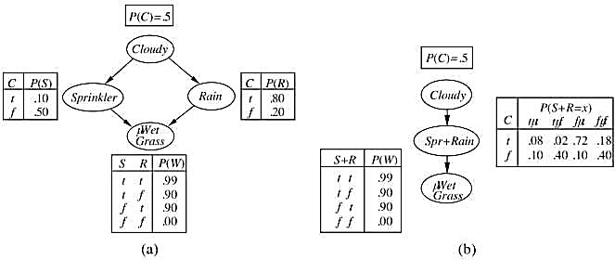
Exact Inference in Bayesian Networks
Clustering algorithms
Mr. Prayag Patel
Department: IT/ICT-LJIET

Slide 51
Approximate Inference in Bayesian Networks
Probabilistic reasoning
Assistant Professor
IT-ICT Department, LJIET
prayag.patel@ljinstitutes.edu.in
Mr. Prayag Patel

Slide 52
Approximate Inference in Bayesian Networks
Difficult to calculate multiply connected networks
It is essential to consider approximate inference methods
Monte Carlo algorithms
Randomized sampling algorithms
two families of algorithms: direct sampling and Markov chain sampling
Apply to the computation of posterior probabilities
Mr. Prayag Patel
Department: IT/ICT-LJIET

Slide 53
Approximate Inference in Bayesian Networks
Direct sampling methods
Primitive element is the generation of samples from a known probability distribution
Sampling process for Bayesian networks generates events from a network
In topological order
The probability distribution is conditioned on the values already assigned to the variable’s parents
Mr. Prayag Patel
Department: IT/ICT-LJIET

Slide 54
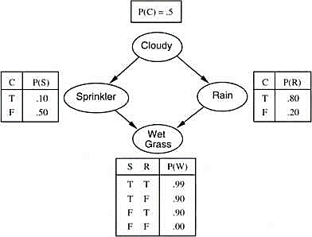
Approximate Inference in Bayesian Networks
Direct sampling methods
Ex. Assuming an ordering
[Cloudy, Sprinkler, Rain, WetGrass]
1. Sample from P(Cloudy) P(Cloudy) = <0.5, 0.5>
Cloudy = True
Mr. Prayag Patel
Department: IT/ICT-LJIET

Slide 55
Approximate Inference in Bayesian Networks
Direct sampling methods
Ex. Assuming an ordering
[Cloudy, Sprinkler, Rain, WetGrass]
2. Sample from P(Sprinkler|Cloudy=true) P(S|C=true) = <0.1, 0.9>
Sprinkler = false
Mr. Prayag Patel
Department: IT/ICT-LJIET

Slide 56
Approximate Inference in Bayesian Networks
Direct sampling methods
Ex. Assuming an ordering
[Cloudy, Sprinkler, Rain, WetGrass]
3. Sample from P(Rain|Cloudy=true) P(R|C=true) = <0.8, 0.2>
Rain = true
Mr. Prayag Patel
Department: IT/ICT-LJIET

Slide 57
Approximate Inference in Bayesian Networks
Direct sampling methods
Ex. Assuming an ordering
[Cloudy, Sprinkler, Rain, WetGrass]
4. Sample from P(W|S=false, R=true) P(W|S=false, R=true) = <0.9, 0.1> WetGrass = true
In this case, the event
[Cloudy, Sprinkler, Rain, WetGrass]
= [true, false, true, true]
Mr. Prayag Patel
Department: IT/ICT-LJIET

Slide 58
Approximate Inference in Bayesian Networks
Direct sampling methods
Rejection sampling in Bayesian networks
Producing samples from a hard-to-sample distribution used an easy-to-sample distribution
It generates samples from the prior distribution
It rejects all those that do not match the evidence
The estimate P(X =x | e) is obtained by counting how often X =x occurs in the remaining samples
Mr. Prayag Patel
Department: IT/ICT-LJIET

Slide 59
Approximate Inference in Bayesian Networks
Direct sampling methods
Rejection sampling in Bayesian networks
Ex. Estimate P(Rain|Sprinkler=true) using 100 samples.
27 samples have Sprinkler = true
  The rest 73s are false → ignore those 73.
Of the 27 remaining samples.
  n(Rain=true) : n(Rain=false) = 8 : 19
P^(Rain|Sprinkler=true)
= <8/27 : 19/27>
= <0.296 : 0.704>
Rejection sampling is consistent for large number of sampling
Mr. Prayag Patel
Department: IT/ICT-LJIET

Slide 60
Approximate Inference in Bayesian Networks
Direct sampling methods
Likelihood weighting
Sample only nonevidence variables, and weight each sample by the likelihood it accords to the evidence
Mr. Prayag Patel
Department: IT/ICT-LJIET

Slide 61
Approximate Inference in Bayesian Networks
Direct sampling methods
Likelihood weighting
Ex. P(Rain|Cloudy = true, WetGrass = true)
Evidence variable : Cloudy, WetGrass
Order = Cloudy, Sprinkler, Rain, WetGrass
Cloudy (evid.)
Update weight w
w ← w x P(Cloudy = true) = 0.5
Sprinkler(non evid.)
Sample
P(Sprinkler|Cloudy=true) = <0.1, 0.9>
Sprinkler = false
Mr. Prayag Patel
Department: IT/ICT-LJIET

Slide 62
Approximate Inference in Bayesian Networks
Direct sampling methods
Likelihood weighting
Rain(non evid.)
Sample
P(Rain|Cloudy=true) = <0.8, 0.2>
Rain = true
WetGrass(evid.)
Update weight w
w ← w x P(WetGrass=true|Sprinkler = false, Rain=true) = 0.5x0.9 = 0.45
Mr. Prayag Patel
Department: IT/ICT-LJIET

Slide 63
Approximate Inference in Bayesian Networks
Inference by Markov chain simulation
Markov chain
Random process in state space, each state is independent of the previous state(memoryless)
Monte Carlo
A class of randomized algorithm whose running time is deterministic
Markov chain Monte Carlo(MCMC)
A random sampling algorithm sampling each event(state) by randomly moving to the new one
Mr. Prayag Patel
Department: IT/ICT-LJIET

Slide 64
Approximate Inference in Bayesian Networks
Inference by Markov chain simulation
Gibbs sampling in Bayesian networks
A randomized sampling method based on MCMC
Suitable for Bayesian network
Start with an arbitrary state with fixed evidence variables at their observed state
Randomly sampling a value for one of the nonevidence variables X_{i}
The sampling is done conditioned on the current values of the variables in the Markov blanket of X_{i}
Markov blanket = parents, children, children’s parents
Mr. Prayag Patel
Department: IT/ICT-LJIET

Slide 65
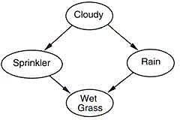
Approximate Inference in Bayesian Networks
Inference by Markov chain simulation
Gibbs sampling in Bayesian networks
Example
P(Rain|Sprinkler = true, WetGrass = true)
Evidence var = Sprinkler, WetGrass
Nonevidence var = Rain, Cloudy
Arbitrarily initialize Rain and Cloudy(say true, false)
[Cloudy, Sprinkler, Rain, WetGrass] = [T,T,F,T]
Mr. Prayag Patel
Department: IT/ICT-LJIET

Slide 66
Approximate Inference in Bayesian Networks
Inference by Markov chain simulation
Gibbs sampling in Bayesian networks
Example: Sampling
P(Rain|Sprinkler = true, WetGrass = true)
Current state
  [Cloudy, Sprinkler, Rain, WetGrass] = [T,T,F,T]
2) Sample Cloudy
  Its Markov’s blanket consists of Sprinkler, Rain.
  Sample from P(Cloudy|Sprinkler=true, Rain=false)
    Suppose we get false
  Move to the next state with changed Cloudy
  [Cloudy, Sprinkler, Rain, WetGrass] = [F,T,F,T]
Mr. Prayag Patel
Department: IT/ICT-LJIET

Slide 67
Approximate Inference in Bayesian Networks
Inference by Markov chain simulation
Gibbs sampling in Bayesian networks
Example: Sampling
P(Rain|Sprinkler = true, WetGrass = true)
Current state
  [Cloudy, Sprinkler, Rain, WetGrass] = [F,T,F,T]
3) Sample Rain
  Its Markov’s blanket consists of Sprinkler, Cloudy, WetGrass.
  Sample from
P(Rain|Sprinkler=true, Cloudy=false, WetGrass = true)
    Suppose we get true.
  Move to the next state with changed Cloudy
  [Cloudy, Sprinkler, Rain, WetGrass] = [F,T,T,T]
Mr. Prayag Patel
Department: IT/ICT-LJIET

Slide 68
Approximate Inference in Bayesian Networks
Inference by Markov chain simulation
Gibbs sampling in Bayesian networks
Ex. Sampling
P(Rain|Sprinkler = true, WetGrass = true)
Current state
Keep doing 2,3 until reaching the number of sampling
Suppose we need to do 80 samplings.
Get 20 states where Rain = true
60 where Rain = False
P(Rain|Sprinkler = true, WetGrass = true)
= α<20,60> = <0.25, 0.75>
Mr. Prayag Patel
Department: IT/ICT-LJIET

Slide 69
Approximate Inference in Bayesian Networks
Inference by Markov chain simulation
Gibbs sampling
Gibbs sampling works at large number of sampling saying that it has reached its stationary distribution.(Converge)
Time spent at each state equals to proportional to its posterior distribution.
Main computation problem
Hard to tell if it has converged.
If Markov’s blanket is large, consume a lot of computational time
Mr. Prayag Patel
Department: IT/ICT-LJIET

Slide 70
Thank you for watching ..
Mr. Prayag Patel
Prayag.patel@ljinstitutes.edu.in

